Slide 1
If you feel that the resources that I have created have helped you save time and/or money, please consider supporting the work that I do by doing your Amazon shopping through TCI By The Lake.
Simply visit the “Amazon Reviews” section (the last tab on the right of my site’s header) or click here before you do your online shopping and check out my product reviews. You’ll be helping out regardless of what you end up buying.
I do not sell my resources on Teachers Pay Teachers or any other platform, so feel free to share whatever you’d like with colleagues.
Please email me at marc@tcibythelake.com if you notice an error or a broken link and I will promptly upload a corrected version. Thank you for your support.
All the best,
Marc Fencil
© Copyright 2018 Marc Fencil ● www.tcibythelake.com ● TCI By The Lake

Slide 2
Imagine that you have to spend the rest of your life on a desert island.

Slide 3
The conditions on the island:
There’s no electricity or cell service.
It’s very hot during the day.
There are many palms (a type of tropical tree).
There isn’t any fresh water on the island except for the rain.
There are many fish in the ocean and bugs in the air.
There are strong currents around the whole island; one couldn’t swim very far.
There are some wild animals on the island.

Slide 4
You can bring one person with you.
Who would you bring and why?

Slide 5
You can only pick four of the following things…

Slide 6
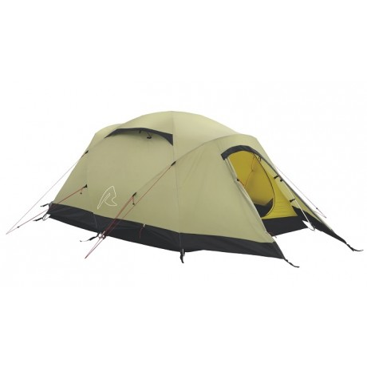
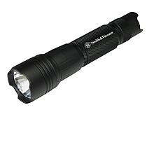
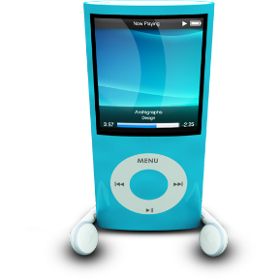
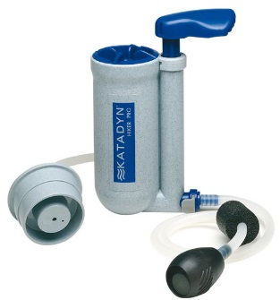
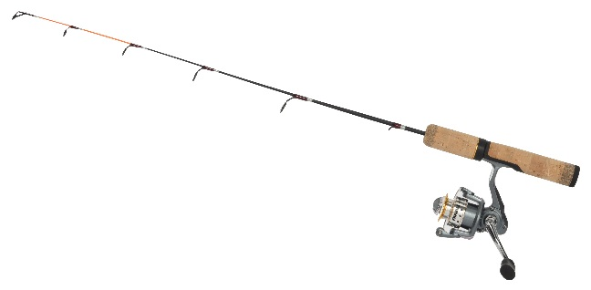
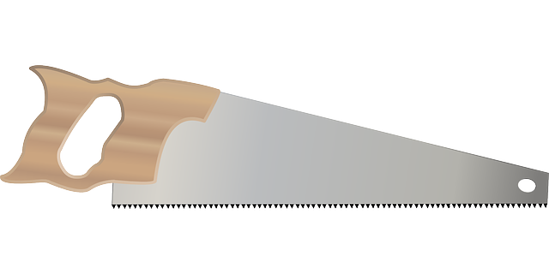
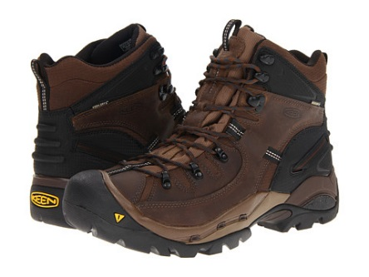
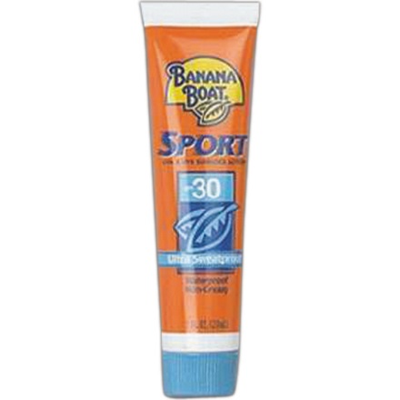
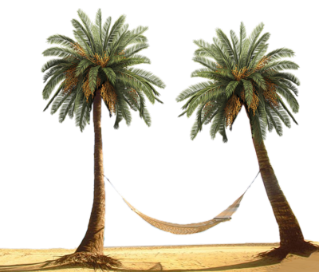
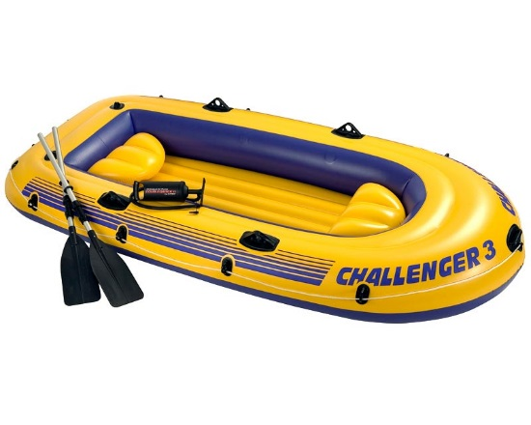
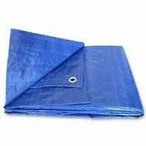
tent
matches
military knife
volleyball
flashlight
hunting rifle
music device
first aid kit
water purifier
compass
fishing pole
frying pan
saw
boots
tarp
insect repellant
raft
toilet paper
sunscreen
hammock

Slide 7
¿And if there zombies on the island? ¿What would you bring then?

